Slide 1

Period End Closing Execution (BSC)
Period End Closing Key Process Areas and New Period End Checks
Posting Period Control
Intercompany and Period End Closing
Lease Accounting and Period End Closing
Cost Management Closing Activities
Period End Closing for Accruals and Recurring Entries
Period End Data Checks
Asset Accounting Closing Activities
VAT Clearing and Reporting
GR/IR Closing Activities
Material Ledger Closing (Non-GSC Activities)
Automatic Clearing of LSC¹⁾ Accounts
G/L Closing Activities for Financial Statement Preparation
¹⁾ LSC – Accounts with indicator “Clearing Specific to Ledger Groups” active.

Slide 2

GR/IR Closing Overview
Block GR Postings of G&A/Marketing and Postings Impacting GR/IR Accounts
Automatic Clearing GR/IR Accounts
GR/IR Regrouping
SIT Reclass
T-Code: ZPERIOD_BLOCK_CD
ZFFITCOMPANY_CD
T-Code:
F.13
T-Code:
F.19
T-Code:
GL Journal/ZFFIA02
FCC Task: Entity Level (Note task in FCC)
FCC Task: Entity Level
FCC Task: Entity Level
FCC Task: Entity Level (Note task in FCC)
Timing:
WD-1(G&A/Marketing)
WD1(GR/IR)
Timing: WD1
Timing: WD1
Timing: WD2 (confirmation that this has been done)
The GR/IR Closing process has not changed from ECC to S/4 HANA. GR/IR Postings are Ledger-through, which post to all ledgers at the same time.

Slide 3
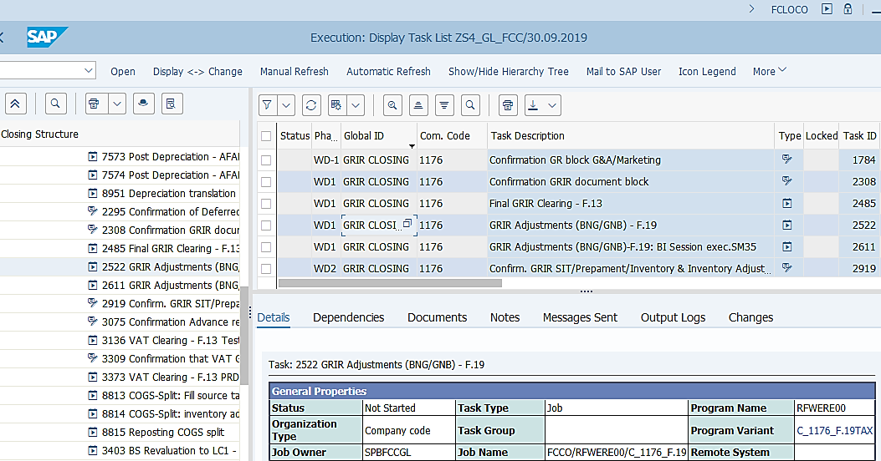
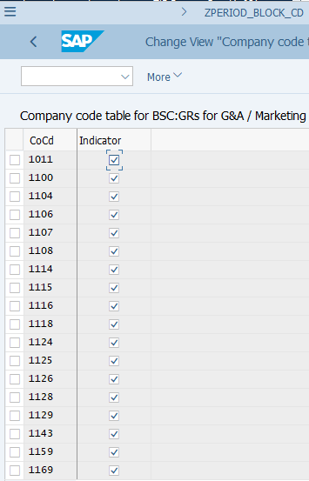
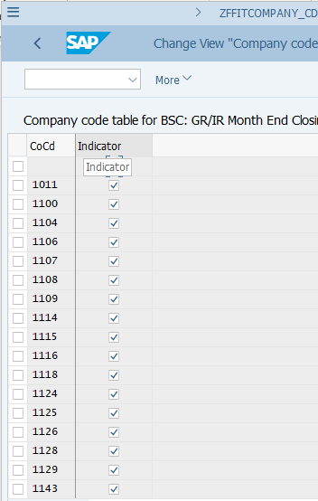
GR/IR Closing: Block of Postings to Accounts
FCLOCO: FCC Task List
¹⁾ Details to be explained in Post Period Closing chapter.
Block GR Postings of G&A/Marketing and Postings Impacting GR/IR Accounts (NO change from ECC to S/4HANA):
These two Z* transactions are designed to allow GBS/JTBC to set a block for the accounts impacting GR/IR for a given entity, so that the GR/IR Closing process can commence.
ZPERIOD_BLOCK_CD blocks all postings with correspondence to General & Administrative and Marketing accounts against GR/IR clearing accounts
ZFFITCOMPANY_CD blocks all postings (except automatic clearing) on GR/IR clearing accounts
These two blocks work together with the key date, which is the last date of the period being closed, set in T-Code ZFFITMONTH_END ¹⁾, i.e. only postings before this date will be blocked so that postings to the new period can continue as normal.
These are Note tasks in FCC, meaning they need to be done outside of FCC manually with status of FCC task manually updated accordingly.

Slide 4
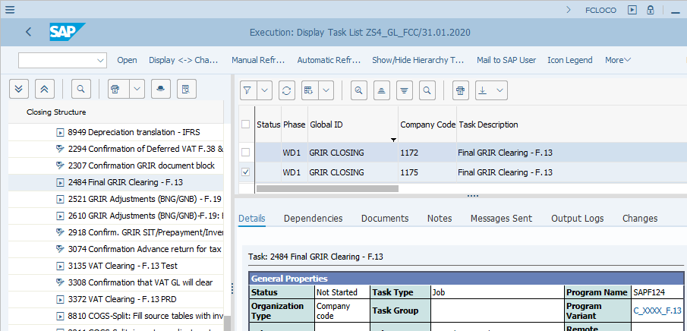
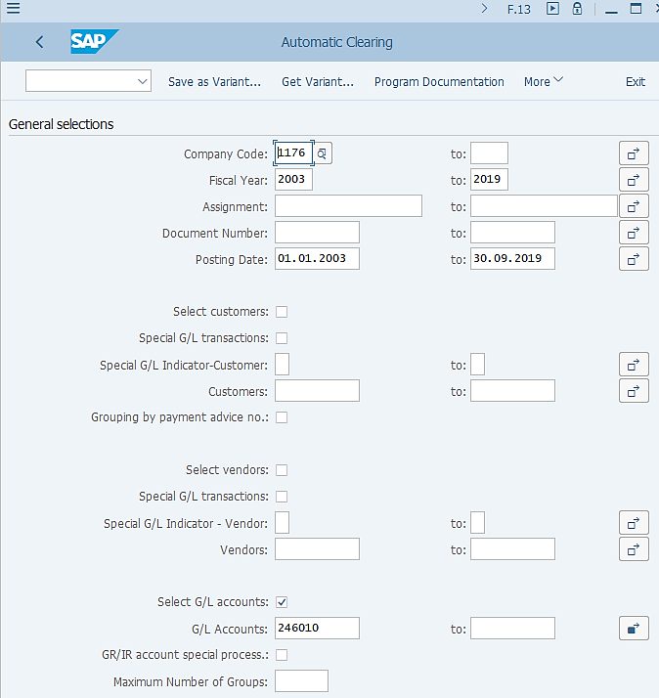
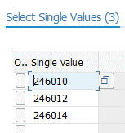
GR/IR Closing: F.13 Automatic Clearing
As described earlier, F.13 variant is a “global variants”. Therefore it is important you review/amend the Company Code field and ensure the Fiscal Year and Posting Date are correct when executing them outside of FCC.
FCLOCO: FCC Task List
F.13: Automatic Clearing
Automatic Clearing of GR/IR Clearing Accounts (No change from ECC to S/4HANA):
Automatic Clearing for GR/IR Clearing Accounts (246010, 246012 and 246014) is performed at period end after GR/IR movements have stopped (blocks are set) and prior to GR/IR Regrouping (F.19).
In S/4 automatic clearing for GR/IR accounts are executed without tolerance for all entities. This eliminates the possibility that some GR/IR open items which do not match 100% but with a small difference which fall inside the tolerance limit are cleared by mistake. At the same time, auto-clearing without tolerance may result in GR/IR open items to be open for a long time, unless entities regularly perform PO maintenance to balance them.
The effect of F.13 is that only open items representing outstanding GRs (in the case of invoice received but goods not received) or IRs (in the case of goods received but invoice not received) are left, which becomes the base for F.19 regrouping.
As F.13 variant used in FCC tasks is a “global variant”, you should always review/amend the Company Code and all the date/period/year fields before executing F.13 outside of FCC.
For details of Automatic Clearing process, please refer to Parallel Ledger course.

Slide 5
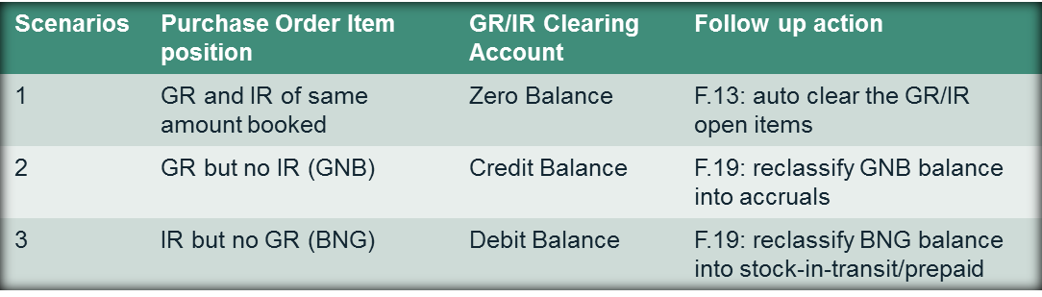
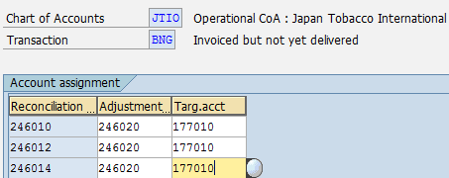
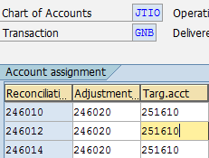
GR/IR Closing: F.19 GR/IR Regrouping (1/8) The GR/IR Concept
In SAP GR/IR Clearing accounts are used as contra accounts to record goods receipts (GR) and invoice receipts (IR) against a purchase order
GR/IR Clearing accounts are open item managed balance sheet accounts which do not normally allow manual posting
This enables users to analyse GR/IR position at the end of the month to identify
In JTI the following accounts are used for GR/IR booking and regrouping

Slide 6
GR/IR Closing: F.19 GR/IR Regrouping (2/8) The GR/IR Concept
Example – Scenario 1 (GR=IR)
Purchase Order for Stationary
Quantity planned = 5
Price planned = 3 USD
Price actual = 3.5 USD
Goods and Invoice Receipts:
1) Quantity received=4
2) invoice for 4 inventory at the actual price=3.5 USD
Summary of GR/IR Clearing/Adjustment Accounts ¹⁾
At period end, F.13 will have both of these items cleared, leaving no open item in GR/IR clearing accounts.
No calculation or posting will be made when F.19 is executed as both invoice and goods are received with the same value on GR/IR accounts.
2)IR=4*3=12$
1) GR=4*3=12$
12$
12$
P&L Account
Vendor Account (AP)
1)GR=4*3=12$
2)IR=4*3.5=14$
2)IR=4*(3.5-3)=2$
¹⁾ GR/IR Accounts include: 246010, 246012, 246014, which are automatic GR/IR accounts during GR and IR transactions, and 246020 which is the GR/IR adjustment accounts posted during F.19.
Actual Cost=14$

Slide 7
GR/IR Closing: F.19 GR/IR Regrouping (3/8) The GR/IR Concept
Example – Scenario 2 (GNB – Goods no Bill)
Purchase Order for Stationary
Quantity planned = 5
Price planned = 3 USD
Price actual = 3.5 USD
Goods and Invoice Receipts:
1) Quantity received=4
At period end, F.13 has no matching GR/IR open items to clear, i.e. step 2) from Scenario 1 doesn’t happen in this scenario. This can also be the case when GR amount/quantity is higher than IR.
During F.19 the system considers such items as GNB and make an Accrual posting against GR/IR Adjustment account 246020.
Summary of GR/IR Clearing/Adjustment Accounts ¹⁾
3) GR/IR Regrouping 12$
1) GR=4*3=12$
12$
12$
P&L Account
Accruals
1) GR=4*3=12$
3) GR/IR Regrouping12 $
12$
12$
¹⁾ GR/IR Accounts include: 246010, 246012, 246014, which are automatic GR/IR accounts during GR and IR transactions, and 246020 which is the GR/IR adjustment accounts posted during F.19.

Slide 8
GR/IR Closing: F.19 GR/IR Regrouping (4/8) The GR/IR Concept
Example – Scenario 3 (BNG – Bill no Goods)
Purchase Order for Stationary
Quantity planned = 5
Price planned = 3 USD
Price actual = 3.5 USD
Goods and Invoice Receipts:
1) invoice for 4 inventory at the actual price=3.5 USD
At period end, F.13 has no matching GR/IR open items to clear, i.e. step 1) GR from Scenario 1 doesn’t happen in this scenario. This can also be the case when IR amount/quantity is higher than GR.
During F.19 (step 3) the system considers such items as BNG and make an Stock-in-Transit posting against GR/IR Adjustment account 246020.
Summary of GR/IR Clearing/Adjustment Accounts ¹⁾
1) IR=4*3.5=14$
3) GR/IR Regrouping 14$
14$
14$
Vendor Account (AP)
Stock-In-Transit
1) IR=4*3.5=14$
3) GR/IR Regrouping 14 $
14$
¹⁾ GR/IR Accounts include: 246010, 246012, 246014, which are automatic GR/IR accounts during GR and IR transactions, and 246020 which is the GR/IR adjustment accounts posted during F.19.

Slide 9
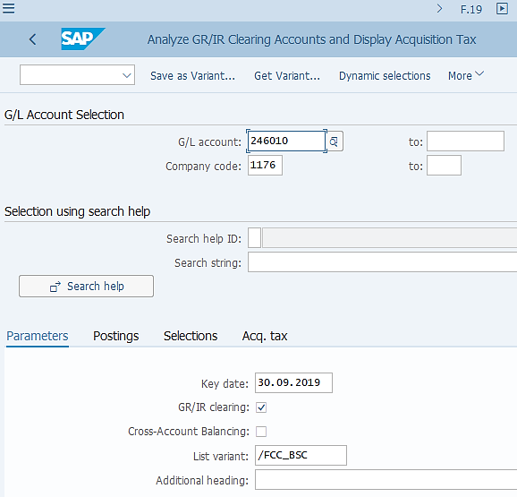
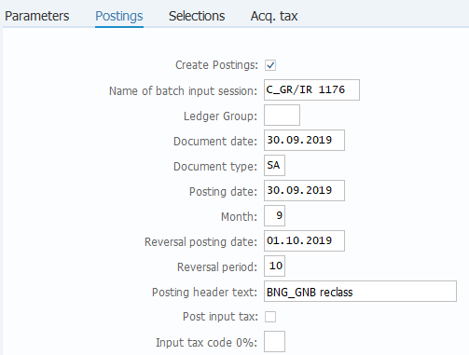
GR/IR Closing: F.19 GR/IR Regrouping (5/8) Execution
FCLOCO: FCC Task List
F.19: Analyze and regroup GR/IR Clearing Accounts
GR/IR Regrouping (F.19) Execution:
F.19 is executed after F.13 based on the GR/IR concept described before. The variants are specific to each company code but use common variables for dates/periods/years fields. You should always review/amend these dates/periods/years fields before executing F.19 outside of FCC.
The key date determines the date by which the GR/IR open items are included in analysis and regrouping.
The List Variants are standardised to allow GBS/JTBC to execute macros for SIT reclass preparation (next step after F.19)
A Batch Input session is generated and needs to be processed to have the BNG/GNB reclassification documents posted.
These postings are made with the last day of the month as posting date and reversed with the posting date of the first date of the following month.

Slide 10
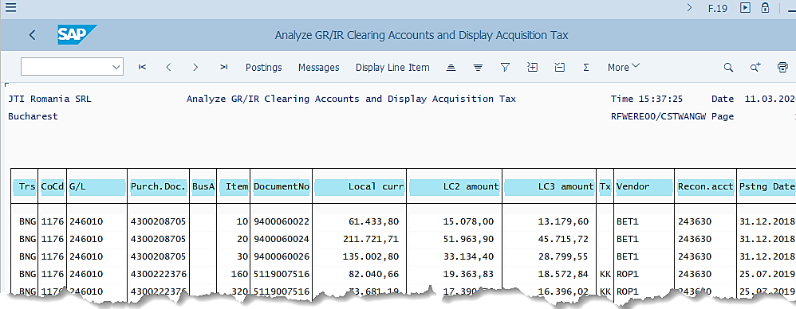
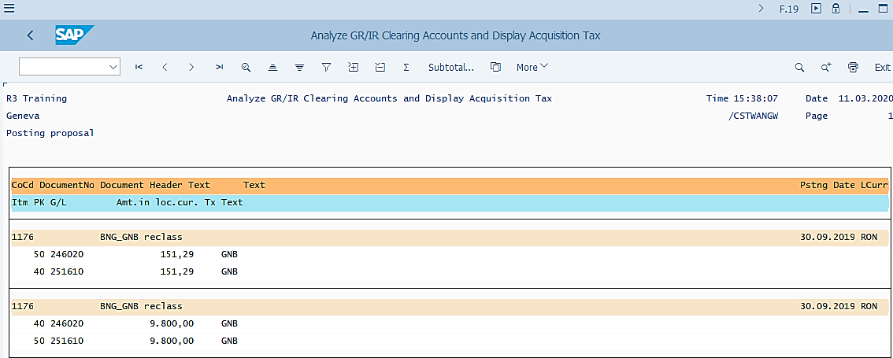
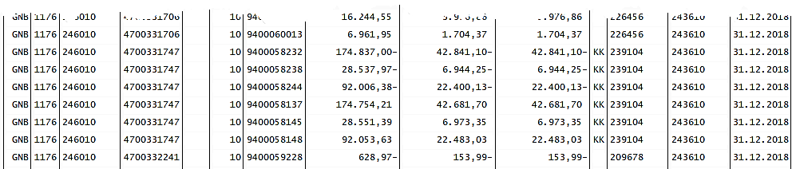
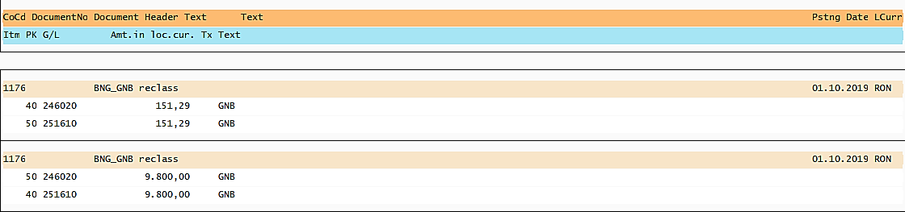
GR/IR Closing: F.19 GR/IR Regrouping (6/8) Output
F.19 output
F.19 Postings tab
GR/IR Regrouping (F.19) Output:
Based on the GR/IR concept described earlier, each Purchase Order Item is classified as either BNG or GNB.
You can display the proposed Postings via the Postings tab and any messages via the Messages tab.
If you need to execute F.19 outside of FCC, make sure you use the same variants as used in FCC tasks and store the output for F.19, the Postings (and Messages if applicable).
As you can see from the proposed postings, the same postings are reversed on day 1 of the following period.

Slide 11
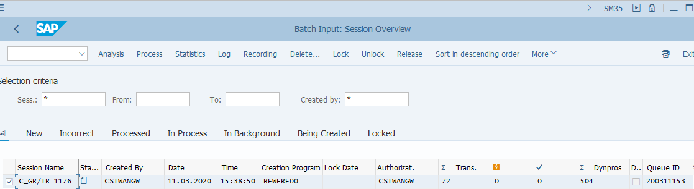
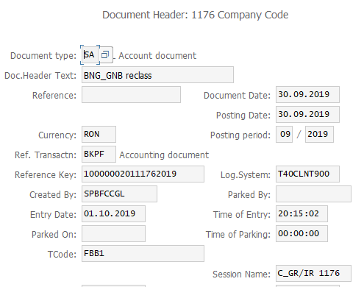
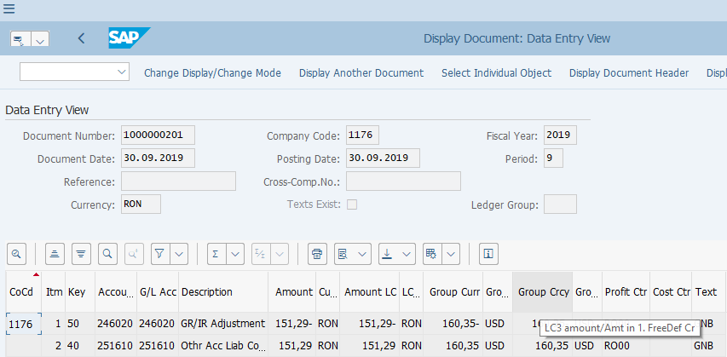
GR/IR Closing: F.19 GR/IR Regrouping (7/8) Postings
SM35: Batch Input Sessions
FB03: Display FI Documents
GR/IR Regrouping (F.19) Postings:
If you execute F.19 outside of FCC you will need to access SM35 to process the batch input session generated in order for postings to be made. FCC will automatically process the session and report a status when done.
The GR/IR Regrouping documents are posted using the Accruals/SIT and GR/IR Adjustment accounts as defined in the configurations described earlier.
These are Ledger-through postings with blank Ledger Group.
The Line Item Text and Document Header contain information which is specific to F.19 documents.
Upon F.19 postings, all GR/IR accounts (246010/12/14/20) should have zero balance in all currencies. (You may use reports such as ZFGL_CTA or CDS Views to check the balance).

Slide 12
GR/IR Closing: F.19 GR/IR Regrouping (8/8) Summary of F.19 Logic – more complicated scenarios
The system logic for F.19 does NOT simply look at the debit or credit balances of the GR/IR open items, but the NATURE of the transactions
Invoices include: Logistic Invoice Verification, Cancellation of Invoices Credit memos, PO Maintenance
Goods Movements include: Goods Receipt, Goods Issue/Delivery, Reversal of Goods Receipt
There are several scenarios for the system to determine GNB or BNG. Pay special attention to scenarios 2.2 and 2.3.
Scenario # | Balance of GR/IR Open Items | Nature of documents booked to PO | F.19 logic of BNG/GNB | F.19 target account | Business Case
1.1 | >0 | Mixture of Invoices and Goods Movements | BNG | JTIO 177010 | Normal GR/IR position when IR is more than GR
1.2 | <0 | Mixture of Invoices and Goods Movements | GNB | JTIO 251610 | Normal GR/IR position when GR is more than IR
2.1 | >0 | Invoices only | BNG | JTIO 177010 | Normal GR/IR position when IR is present but no GR
2.2 | <0 | Invoices only | BNG | JTIO 177010 | Credit memo is posted but no goods return is posted
2.3 | >0 | Goods Movements only | GNB | JTIO 251610 | Reversal of goods receipt is booked but no cancellation of invoice or credit memo
2.4 | <0 | Goods Movements only | GNB | JTIO 251610 | Normal GR/IR position when GR is booked but no invoice is posted

Slide 13
F.19 GR/IR Regrouping Common Errors
Detail of the “Errors” can be checked from the “Output Logs”. GL Team needs to check the error and work as per the resolution mentioned below.
Errors | Error Description (Reason) | Resolution
No session found for the task XXXX | This error occurs when the FCC Task “GRIR Adjustments (BNG/GNB)-F.19: BI Session exec.SM35” is executed and there is no session for the targeted Entity. | Since there is no session to post, GBS/JTBC GL Team should change status to "checked" and add comment “No batch"
Session XXXX not processed yet (Has the status "R“) | Task took more than 99 seconds | GBS/JTBC GL Team needs to check if the Session is processed successfully in SM35. If session is processed successfully then change status to "checked" and add comment "more then 99 seconds“ If session is not processed, then reprocess the session in SM35 and change status to "checked" and add comment "processed"

Slide 14
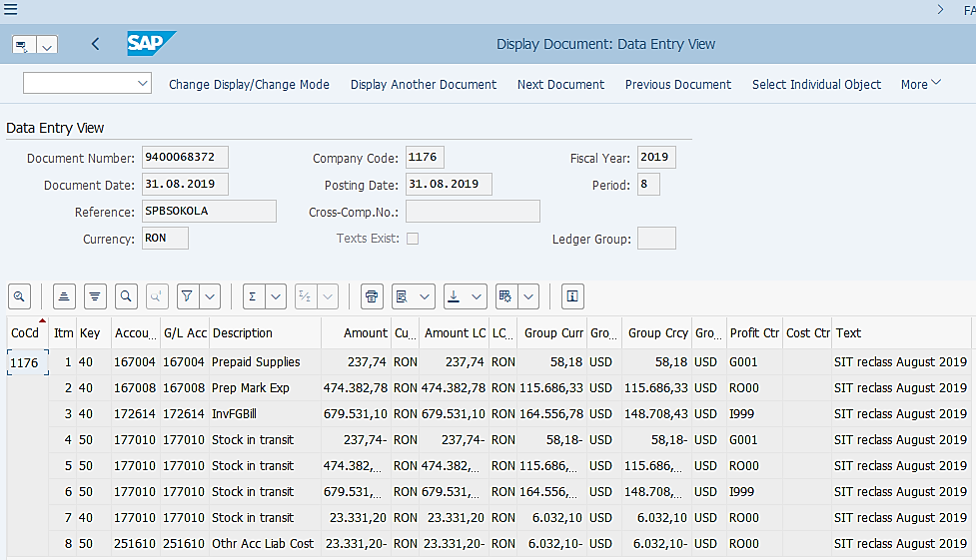
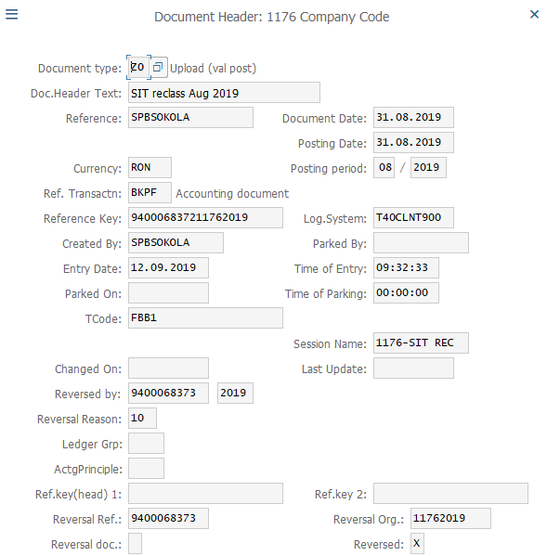
GR/IR Closing: SIT Reclass
FCLOCO: FCC Task List
FB03: Display FI Documents
Stock-In-Transit (SIT) Reclass:
The purpose of SIT Reclass is to reclass the balances booked to G/L 177010, the generic SIT accounts defined in GR/IR Regrouping process, to detailed SIT accounts (e.g. SIT NTM, SIT Finished Goods, etc.) or prepaid accounts, based on Material Group of each PO item. This is a JTI reporting requirement. (In some cases the Accrued Liability account 251610 may be further reclassed depending on the analysis)
The calculation of how much should be reclassified to which accounts are done in Excel based on the F.19 output, which is handled by GBS/JTBC using Macro/Bot. Therefore in FCC you will see this listed as a Note task, which should have its status updated upon the completion of GBS/JTBC posting the SIT Reclass journal via the normal Journal upload process (ZFFIA02).
This process remains the same in S/4 HANA as in ECC. The SIT Reclass document is posted ledger-through with a blank Ledger Group. The document is subsequently reversed on Day 1 of the next period.

